Slide 1
Hidenberg Semester Project SS2025
Aurora, Daniel, Kuba, Rodrigo
Final Project Presentation, 25th June 2025

Slide 2
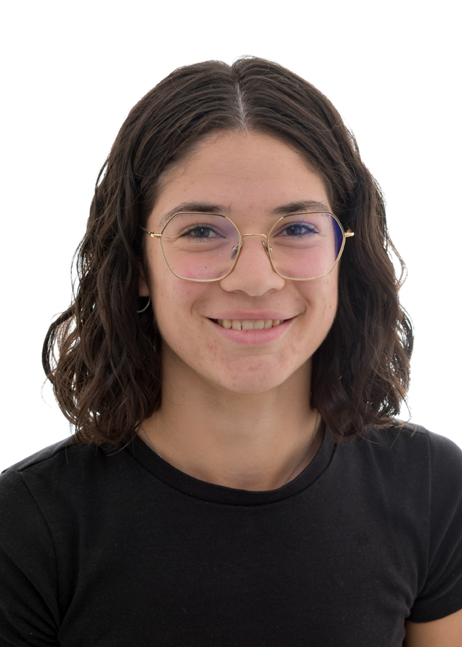
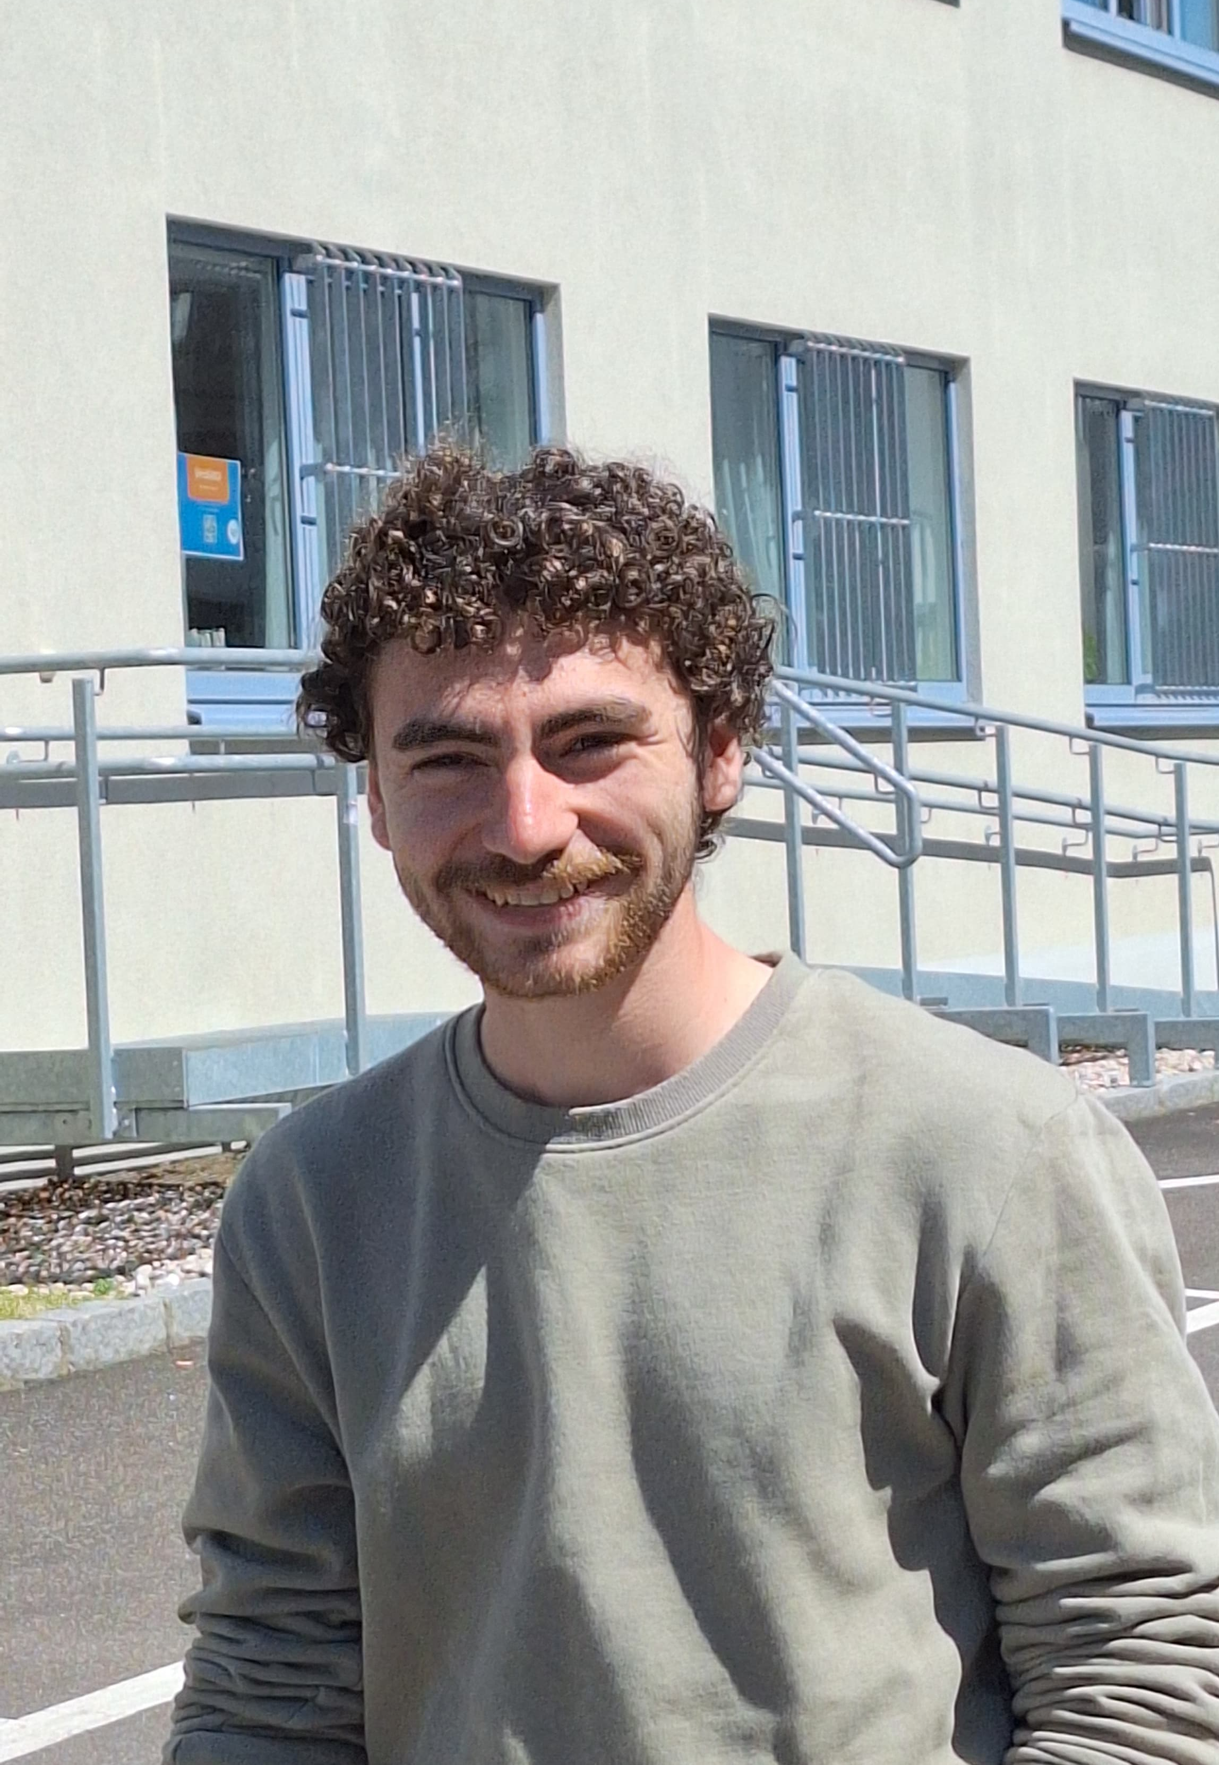
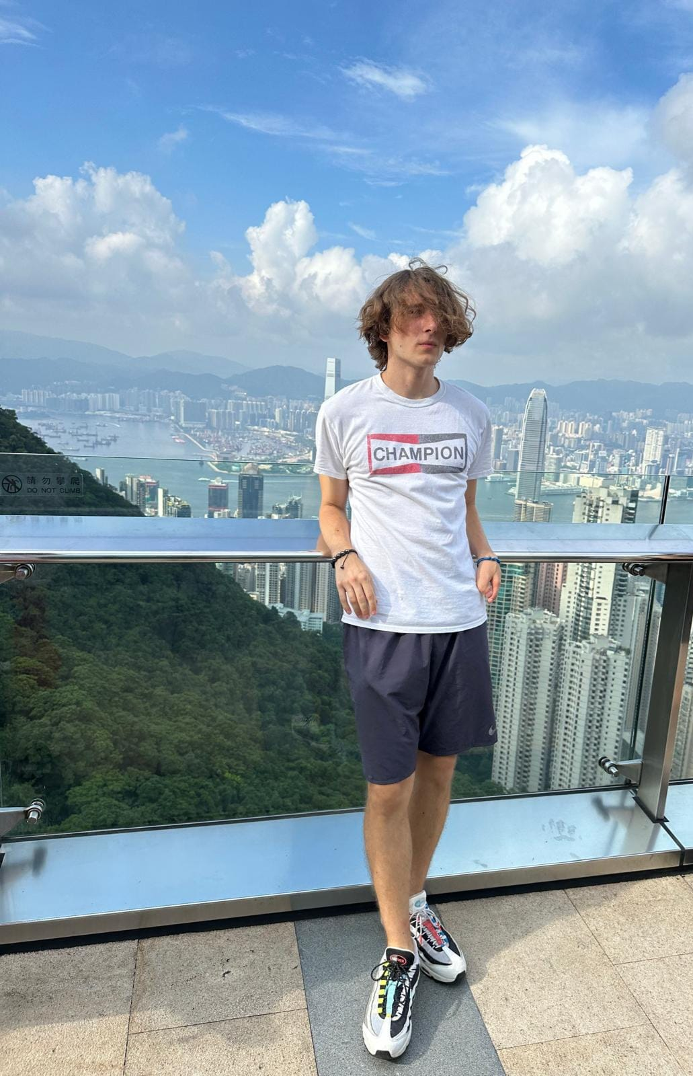
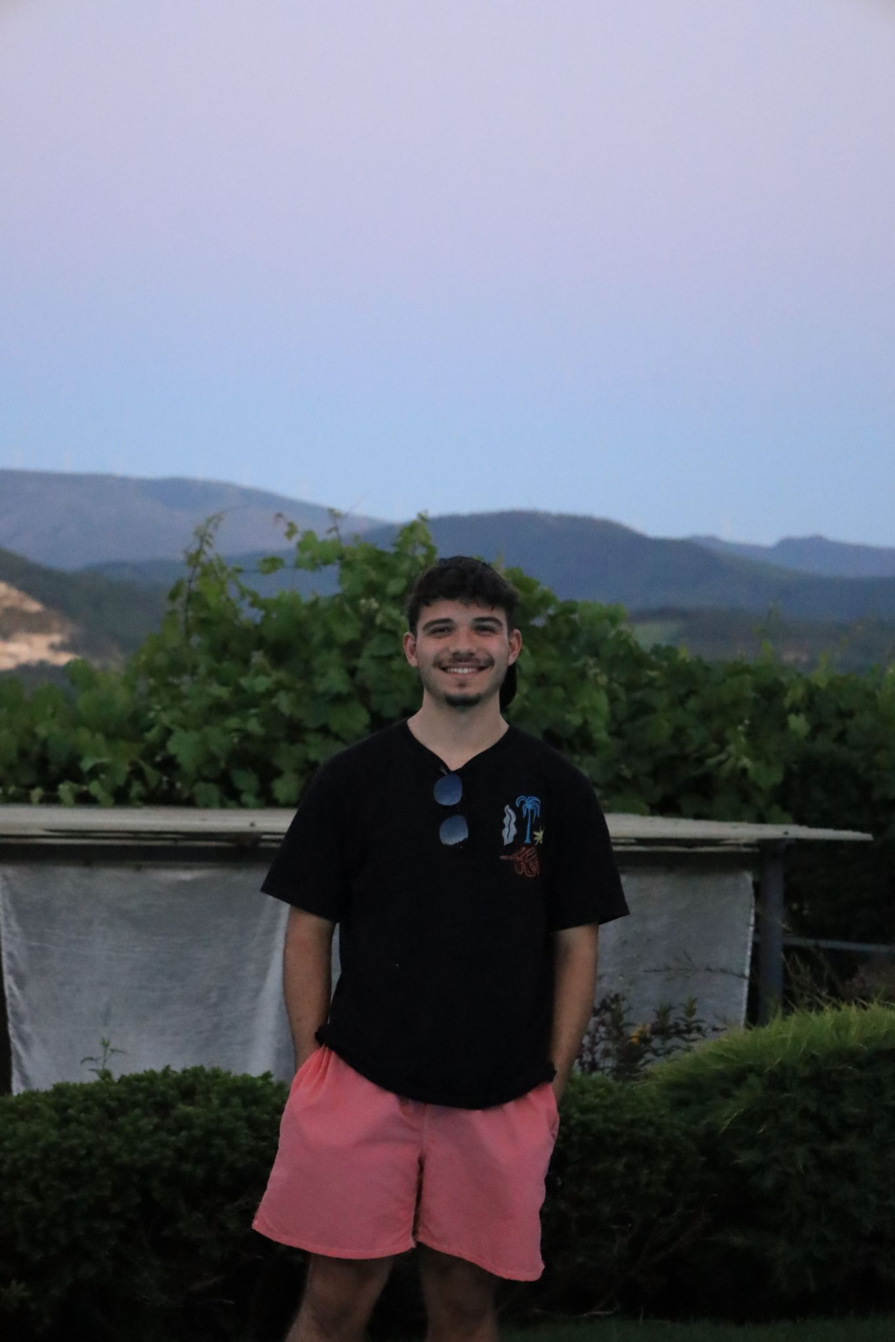
OUR TEAM
AURORA PUJOLS RIAL
DANIEL
MALHEIRO
JAKUB
KLOS
RODRIGO
CASTRO

Slide 3

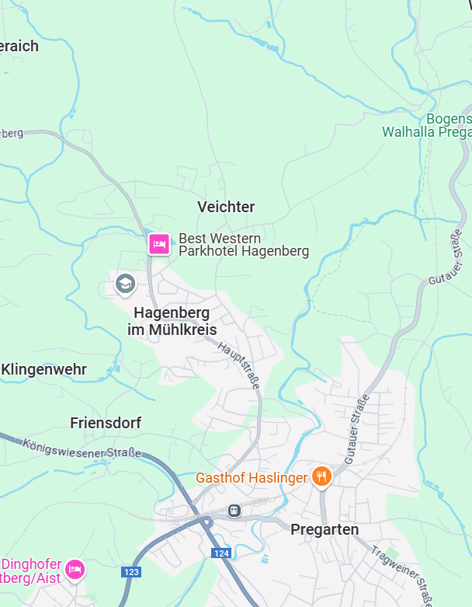

Slide 4




Gain an extra ping
Swap QR
codes
Make hider's phones make sound
Hide your location in next ping

Slide 5
TABLE OF CONTENTS
01
02
03
04
PROJECT ORGANIZATION
LEARNING EXPERIENCES
ARCHITECTURE
DIFFICULTIES & SOLUTIONS
+ GitHub overview

Slide 6
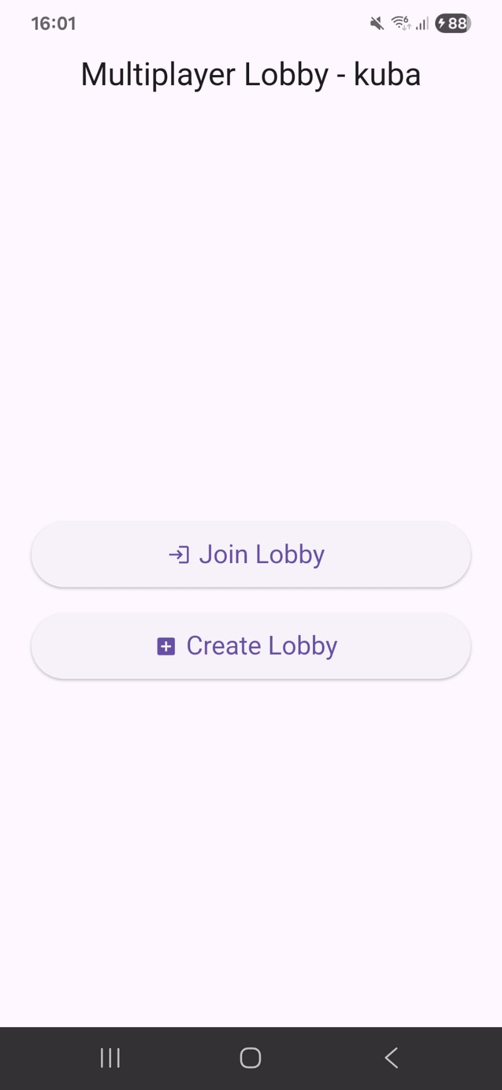
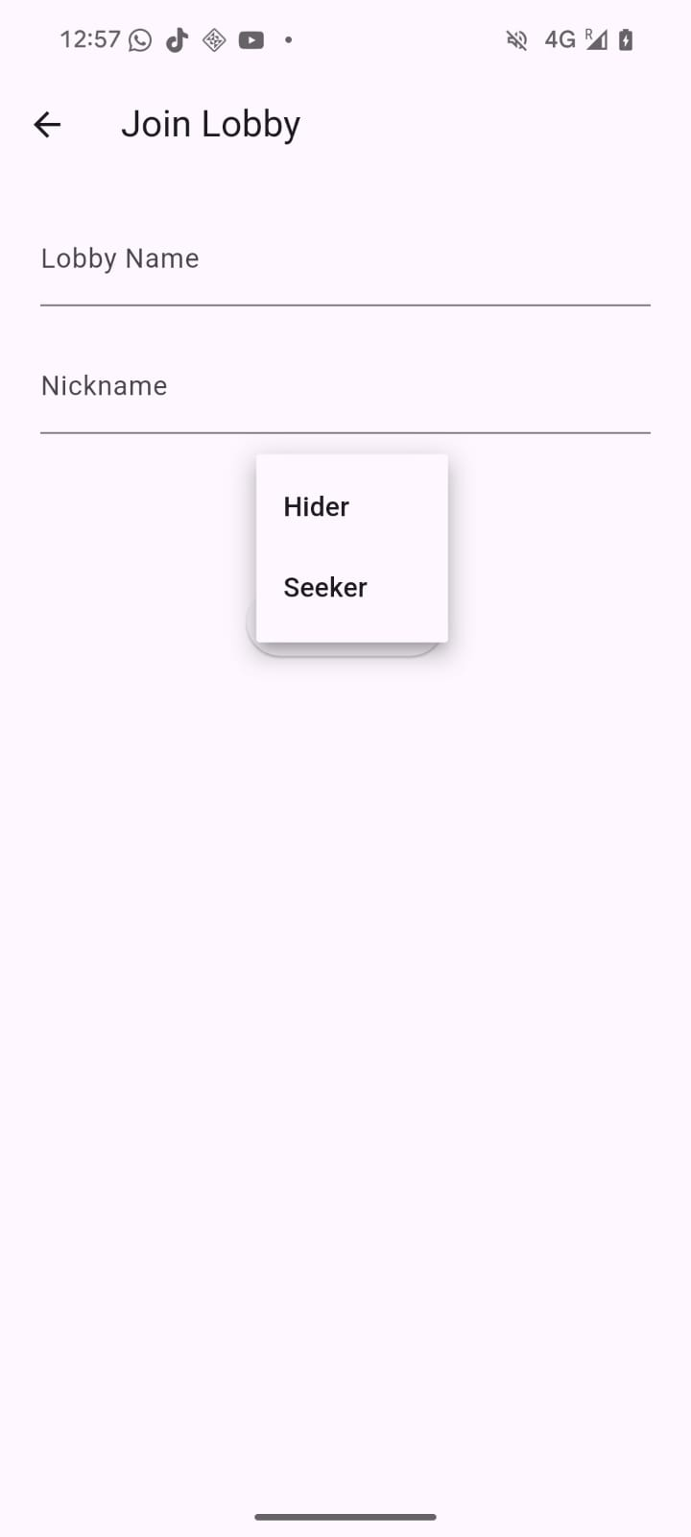
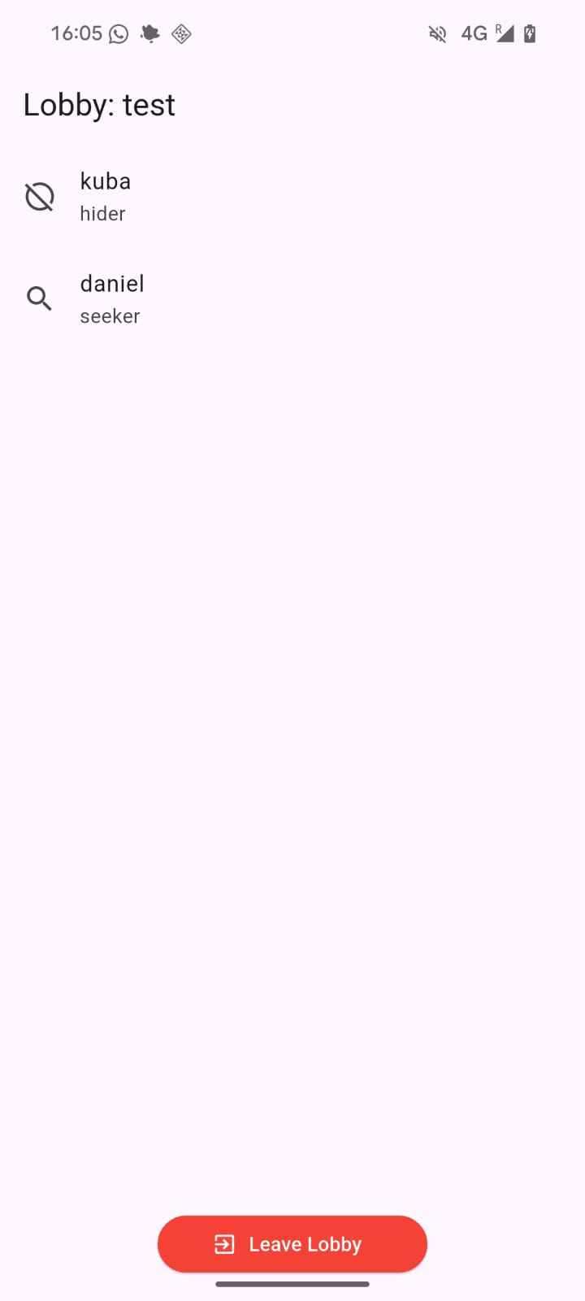
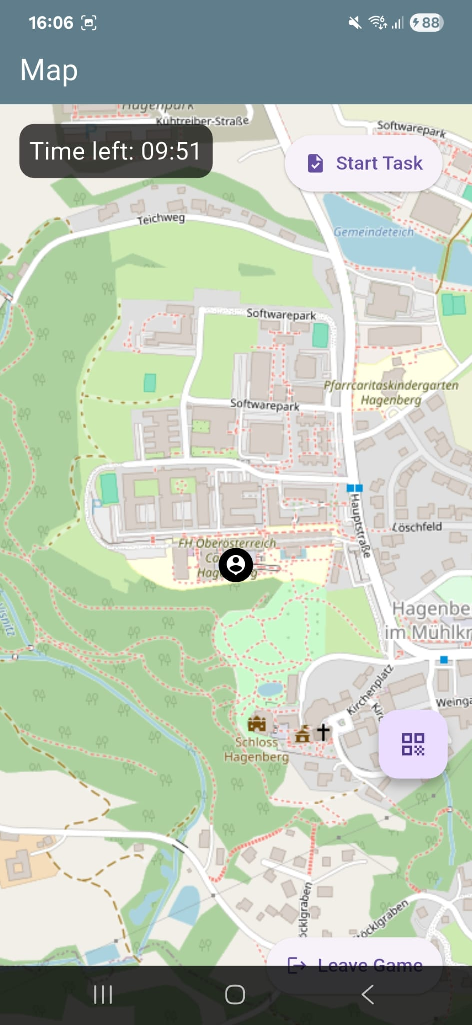
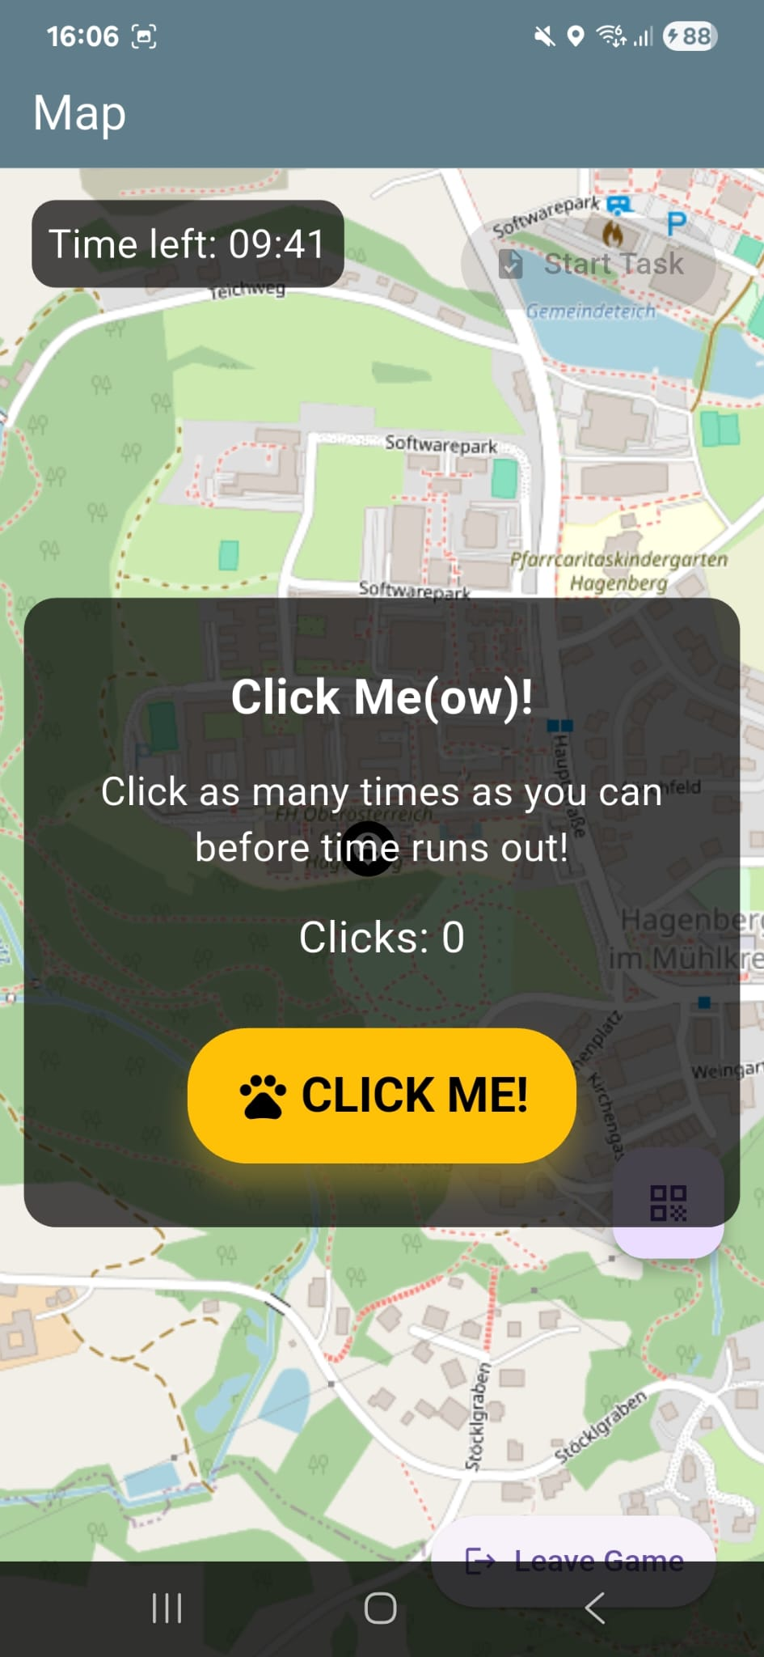
ABOUT THE GAME

Slide 7
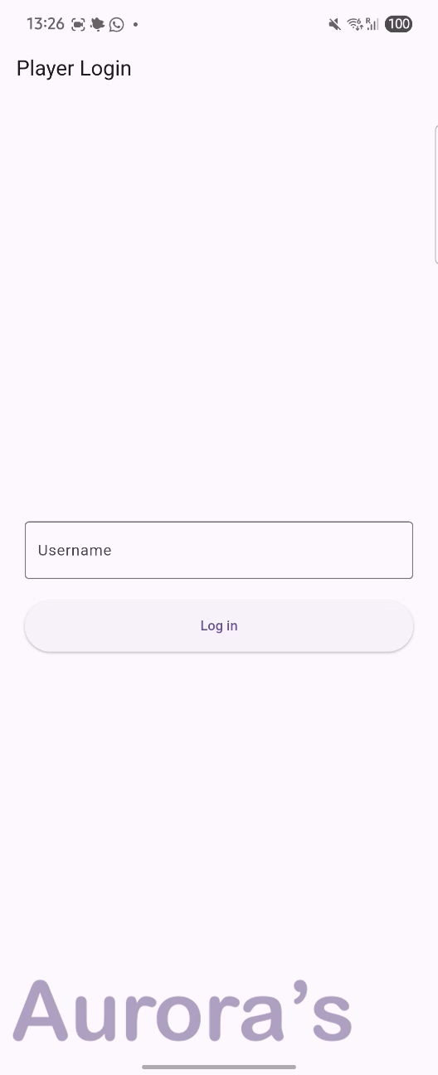

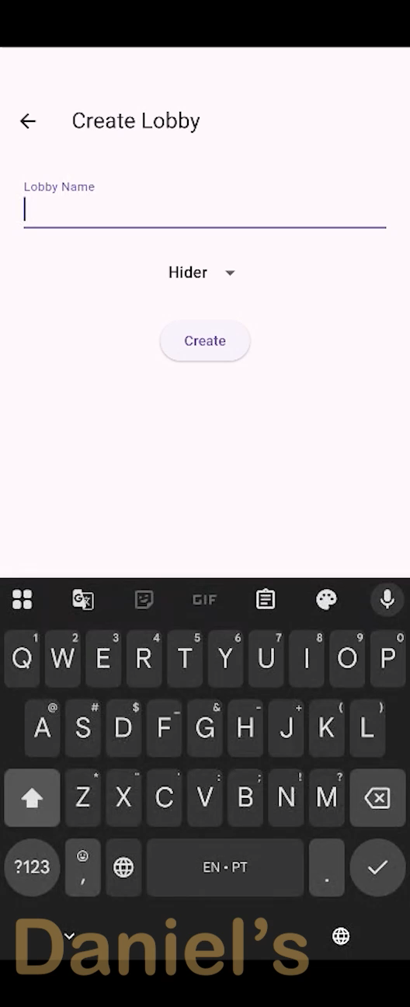
ABOUT THE GAME

Slide 8
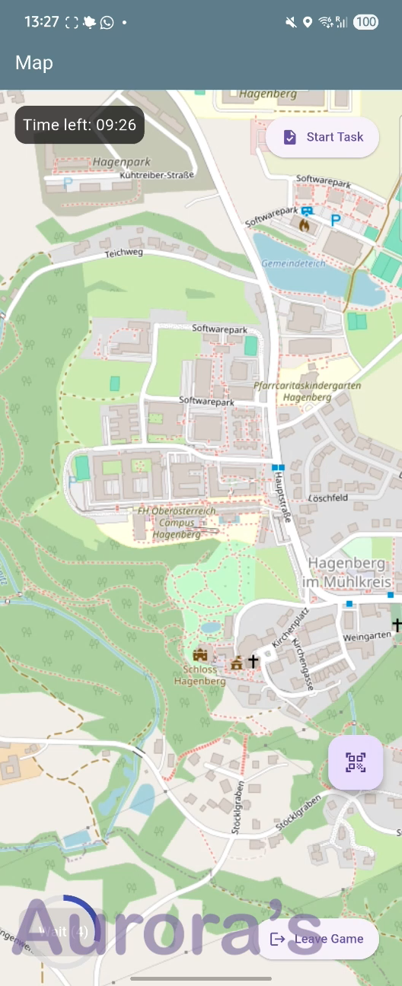
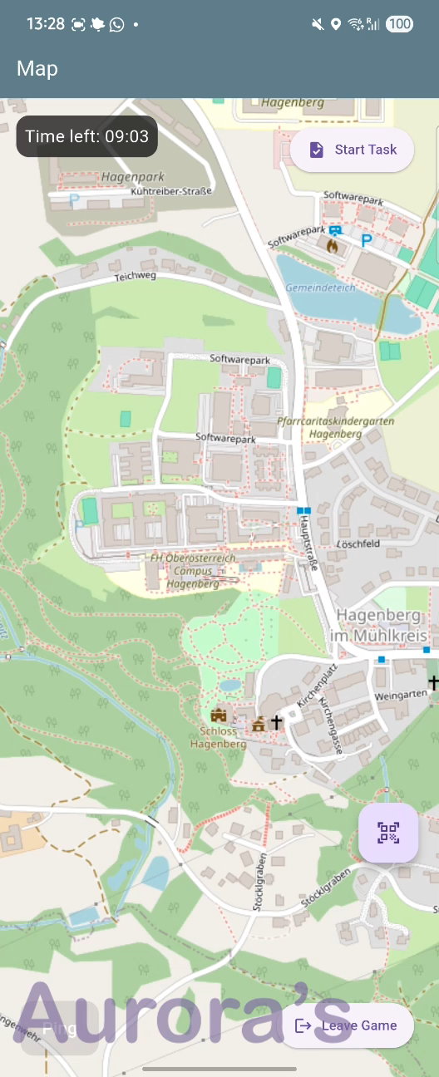

ABOUT THE GAME

Slide 9
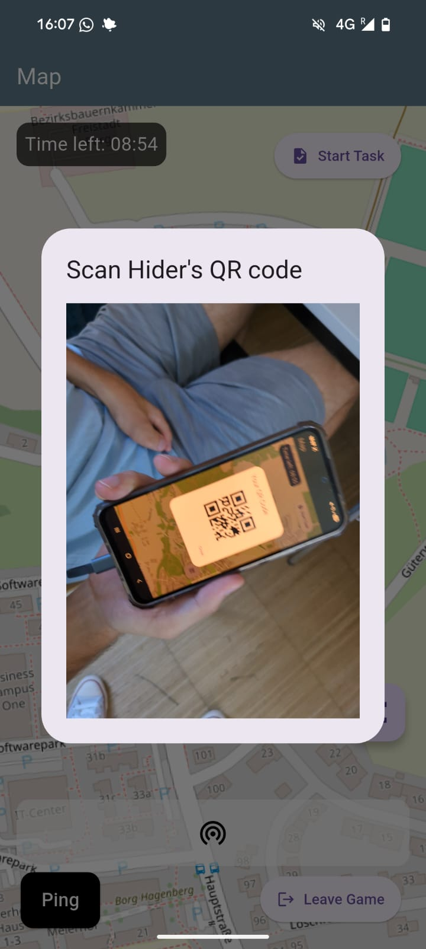
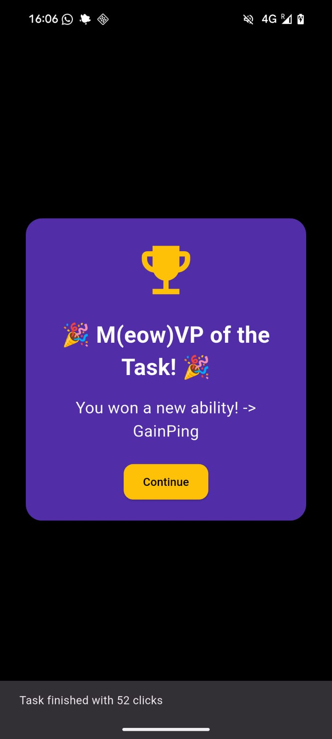
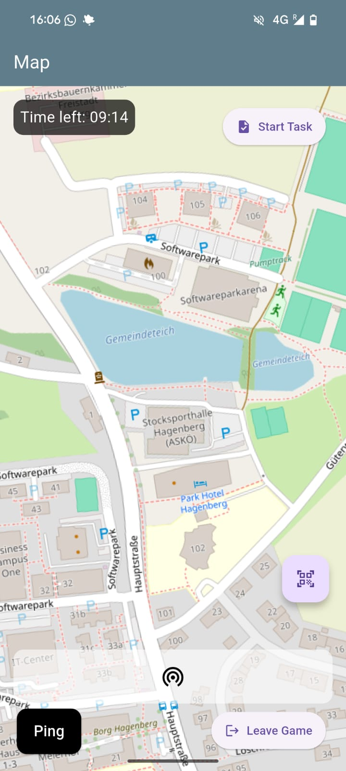
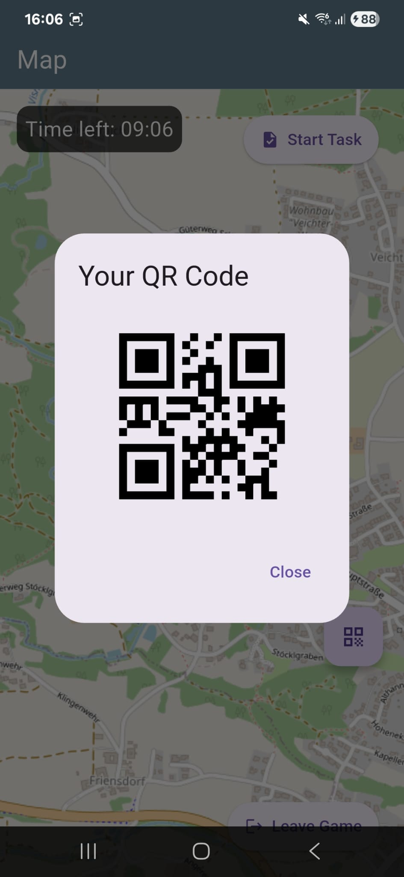
ABOUT THE GAME

Slide 10
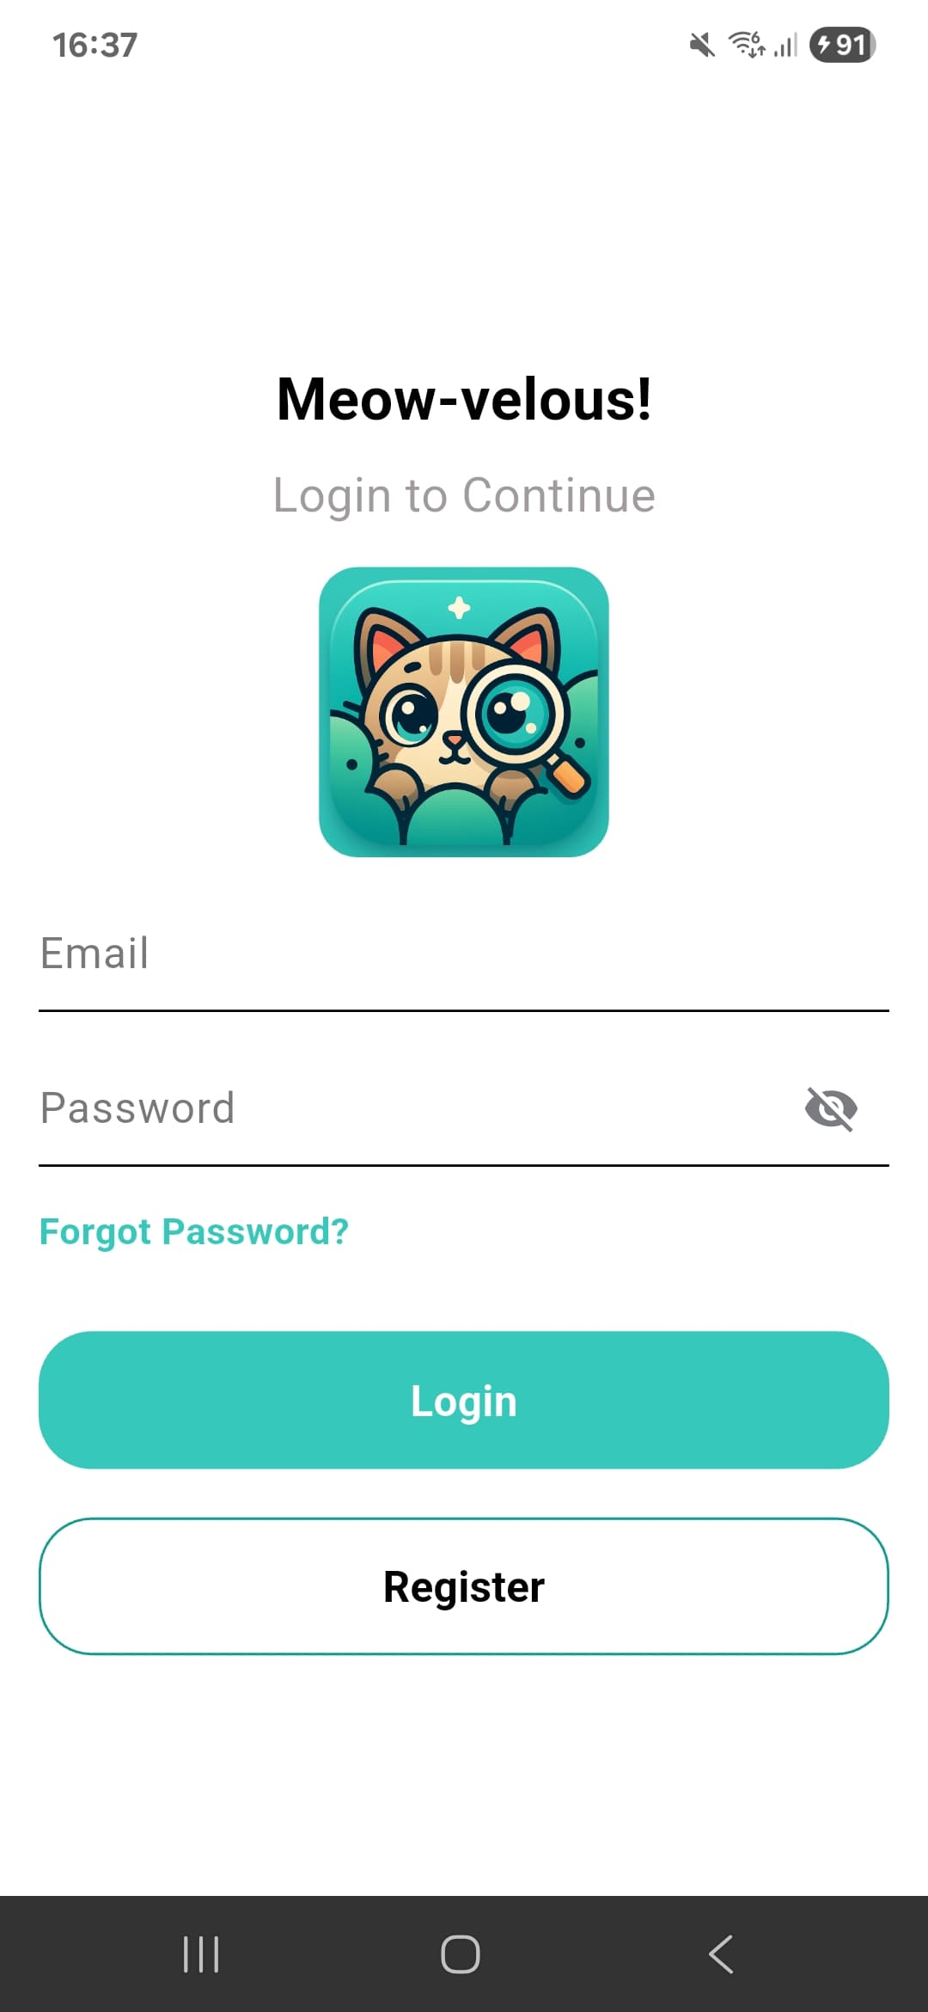
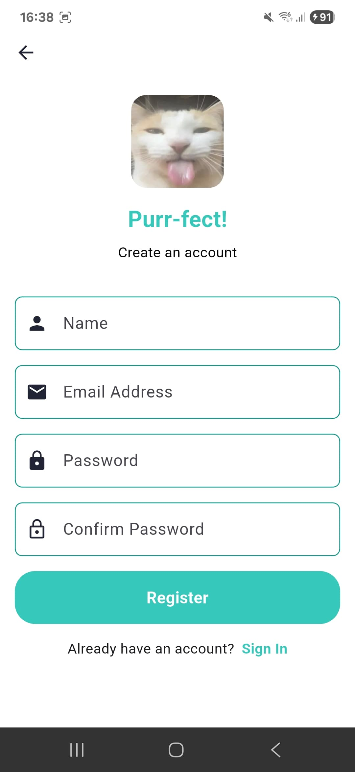
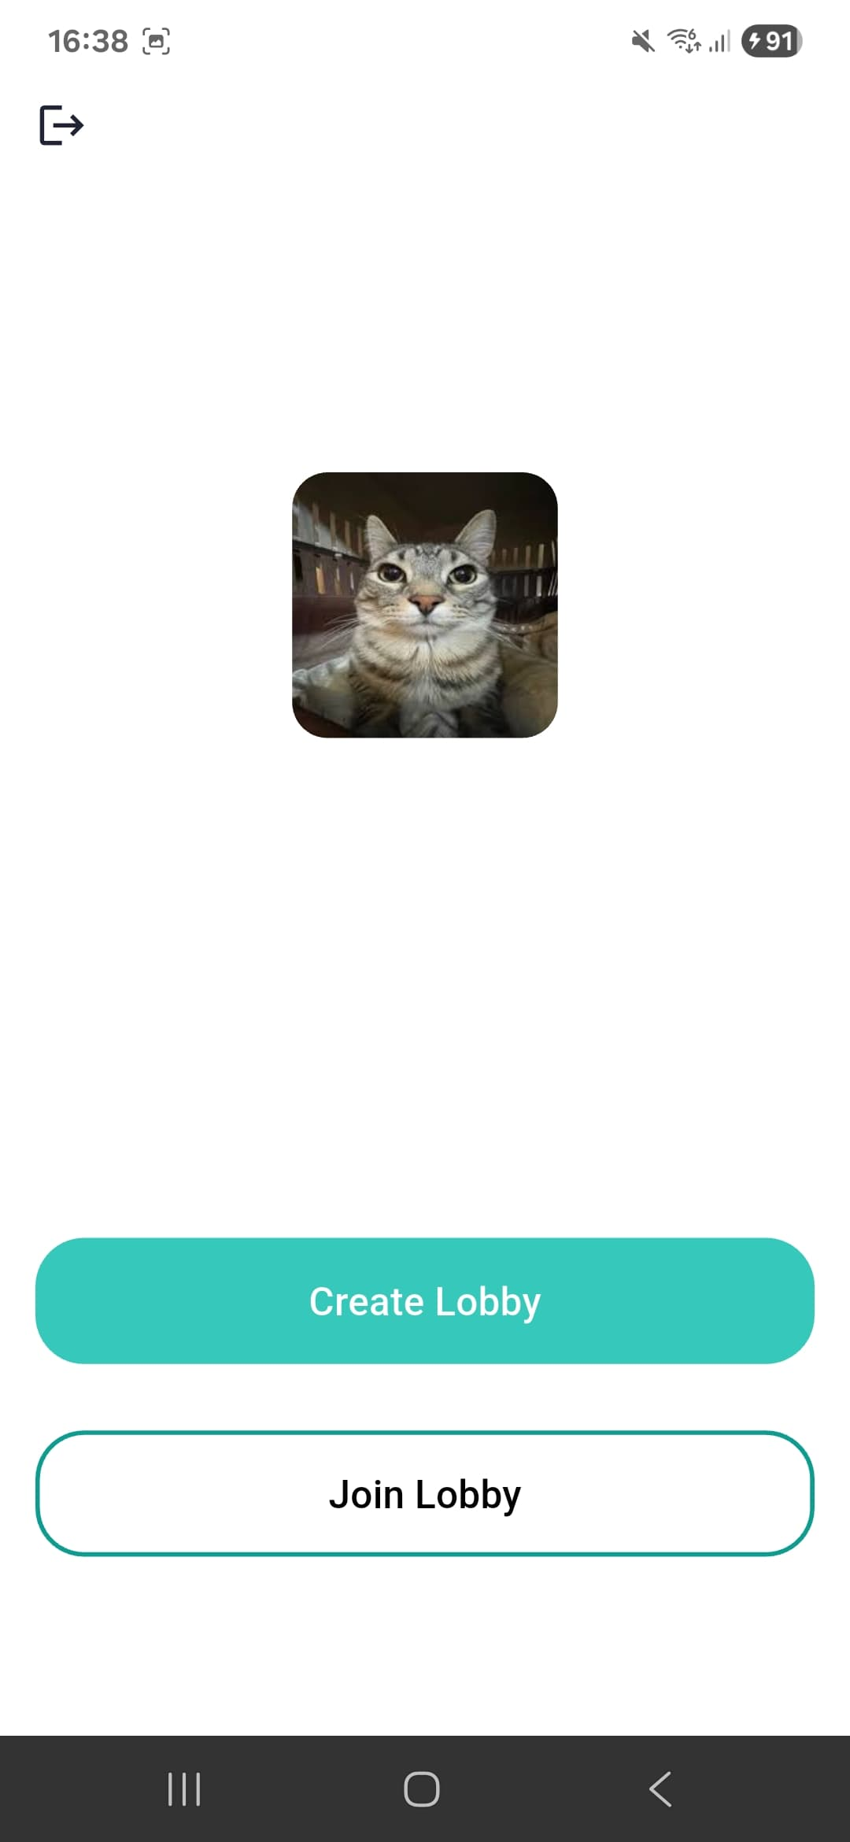
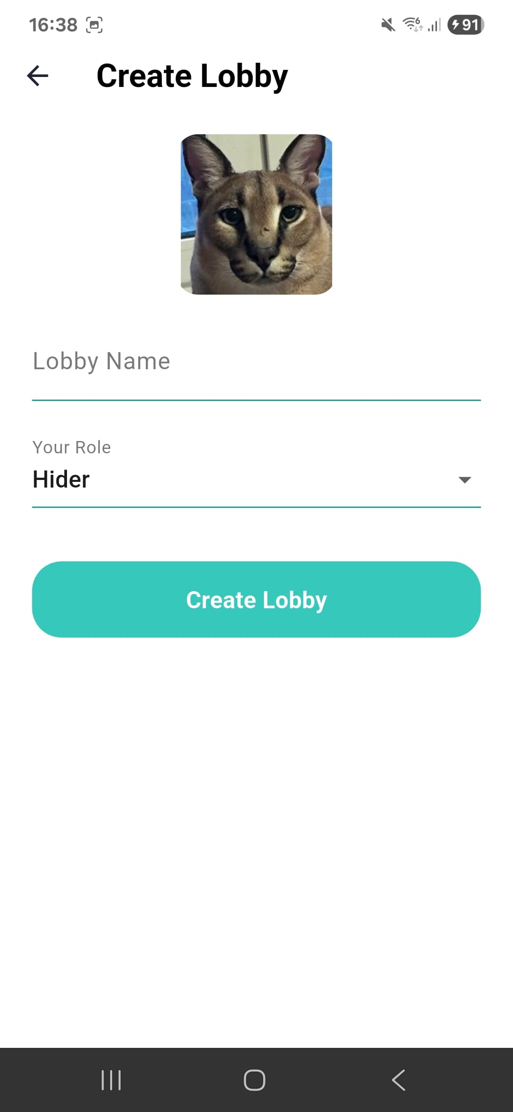
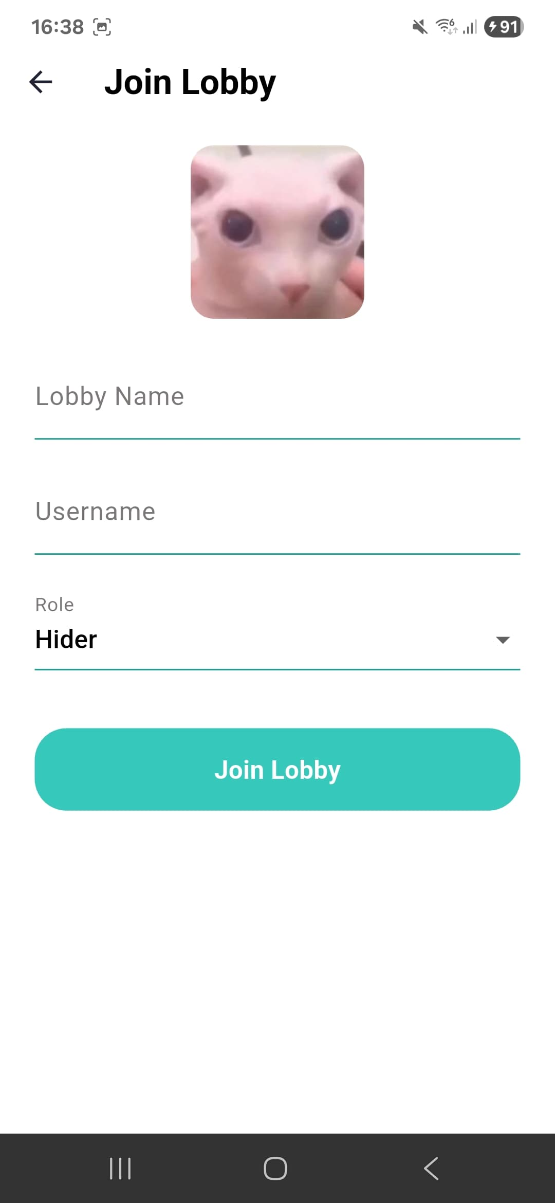
NEW UI

Slide 11

PROJECT ORGANIZATION
Azure
Scrum
Weekly meetings
With / Without Professors
Put together / Code together
GitHub
Discord
tldraw

Slide 12
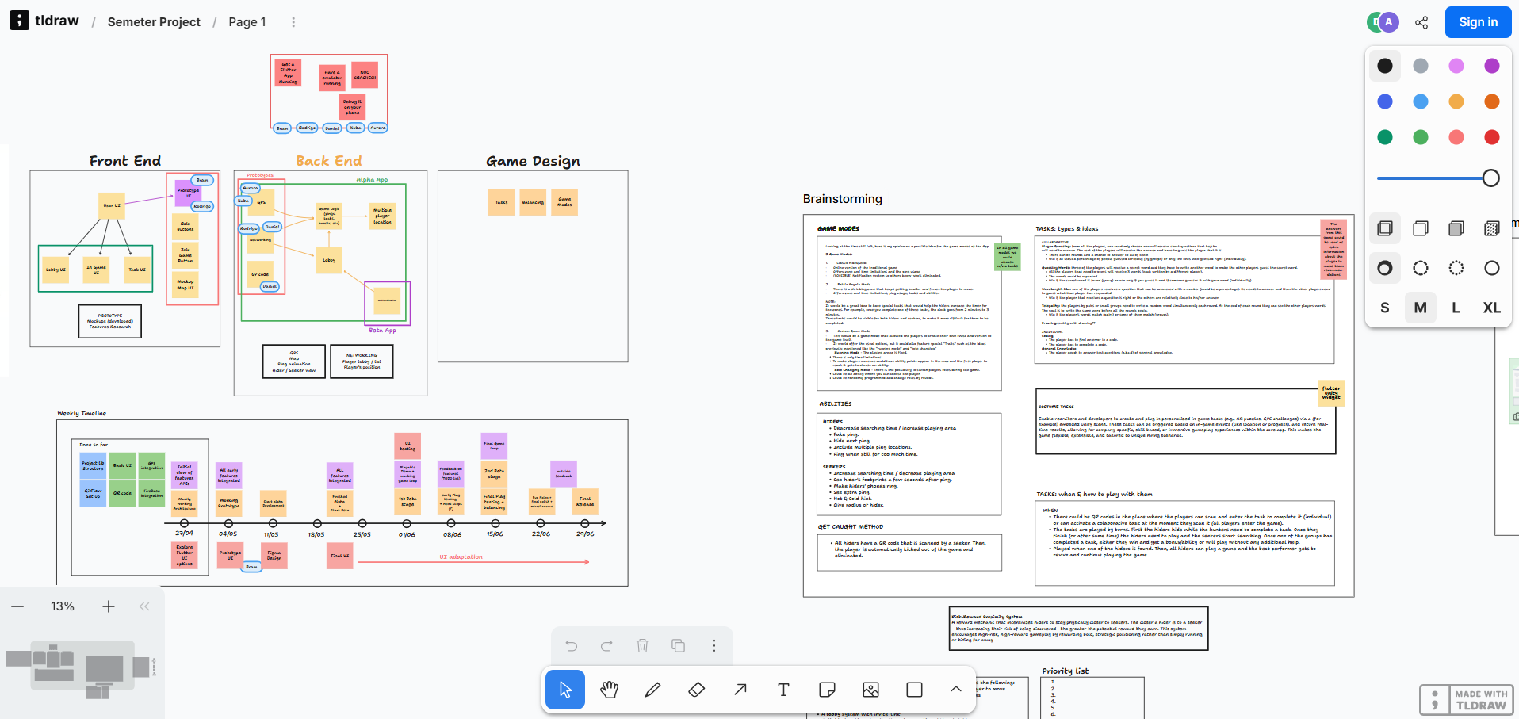
OUR COMPANY
Do you know what helps you make your point clear? Lists like this one:
They’re simple
You can organize your ideas clearly
You’ll never forget to buy milk!
And the most important thing: the audience won’t miss the point of your presentation

Slide 13







TOOLS WE USED

Slide 14
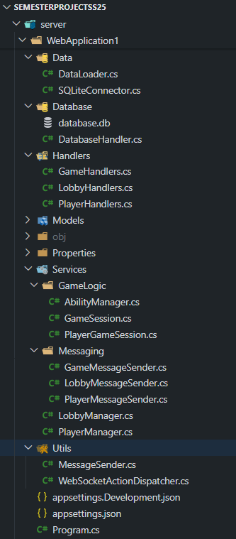
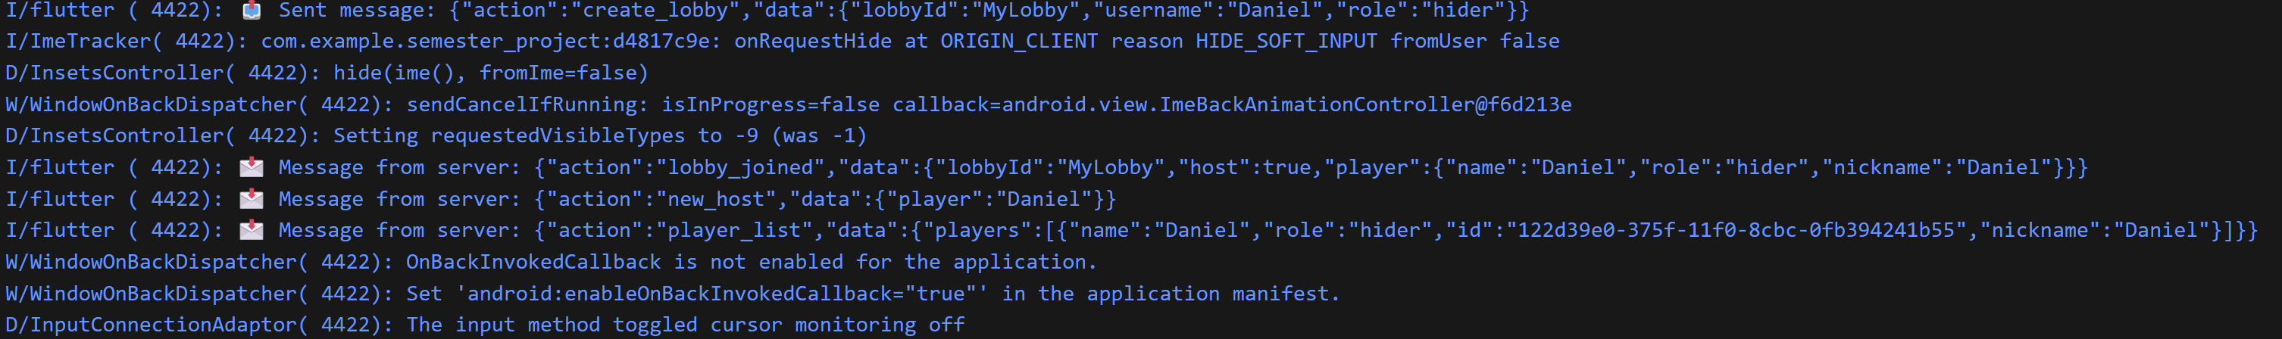
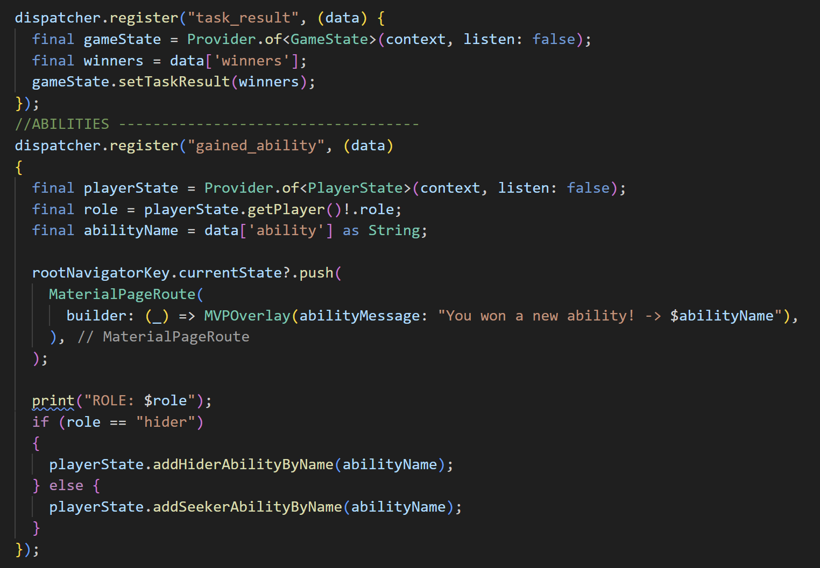
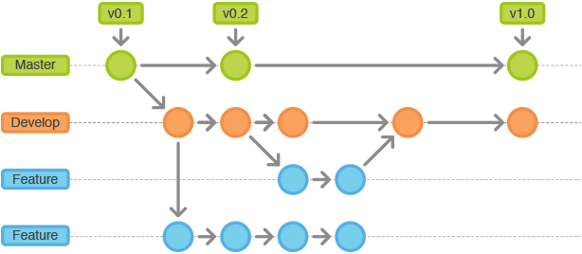
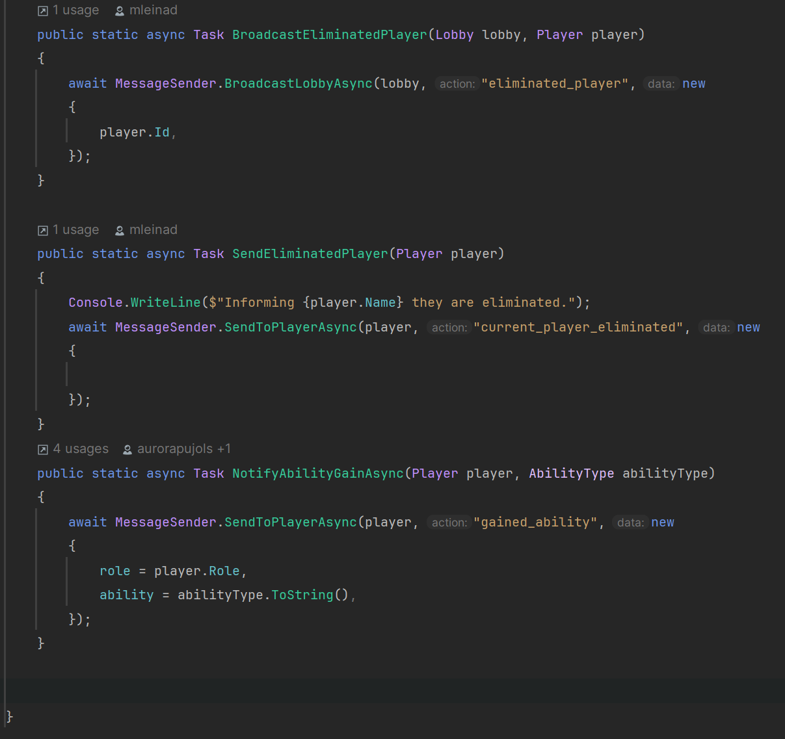
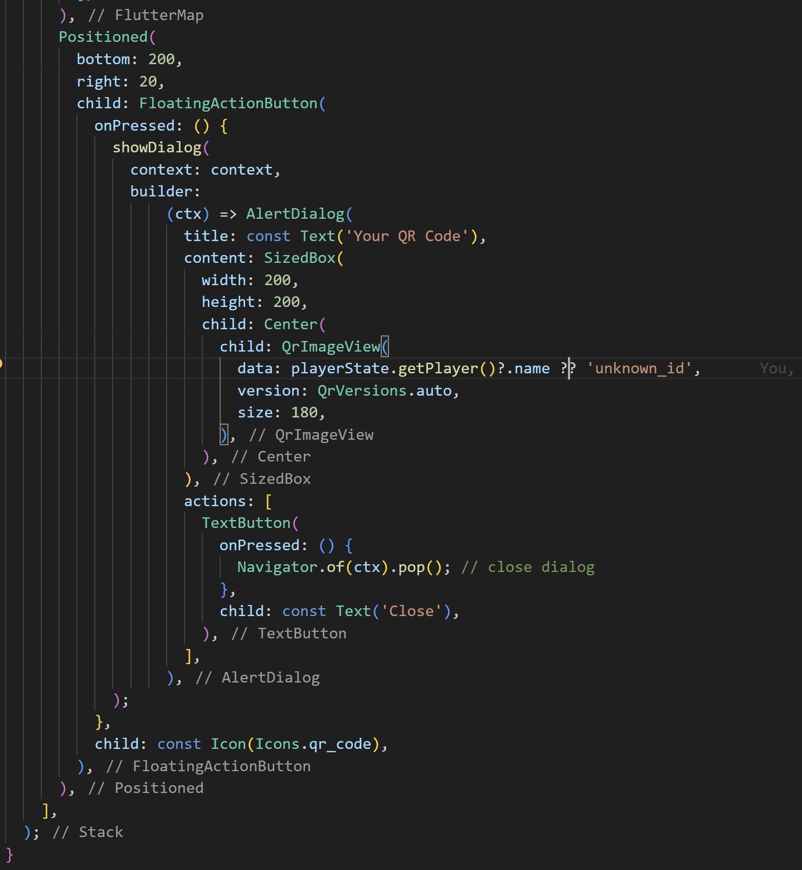
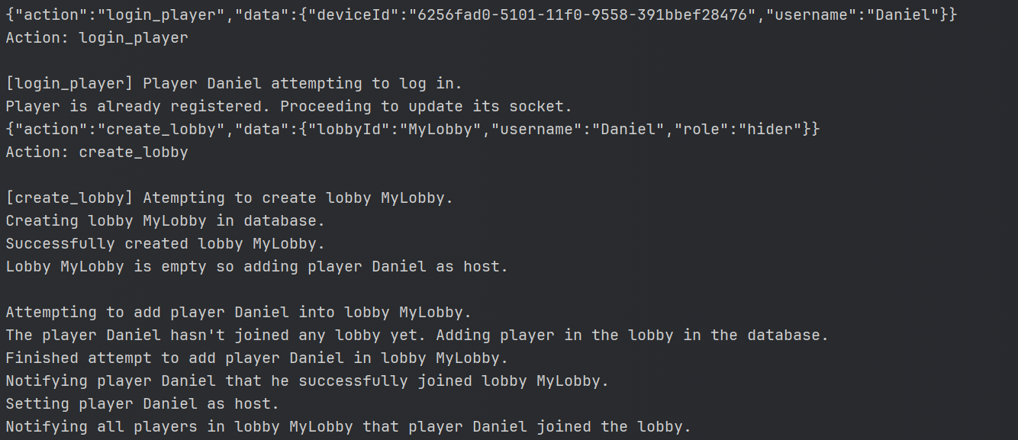
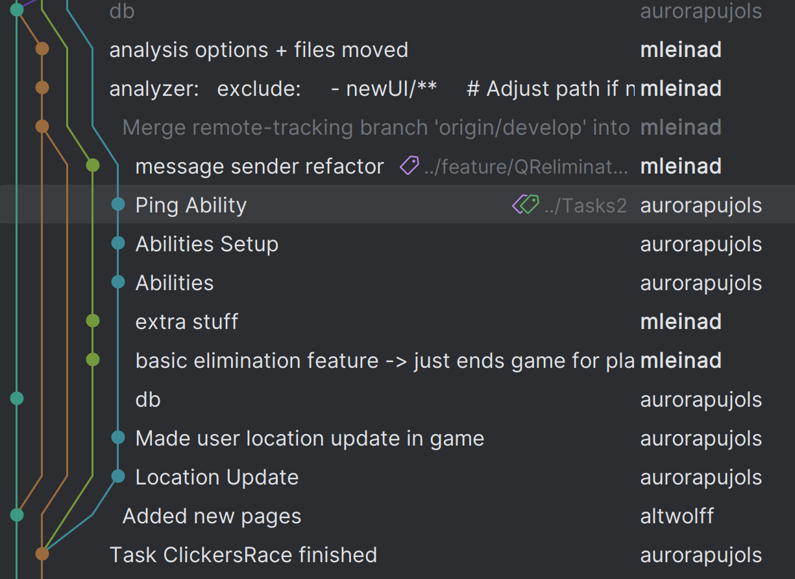
Server
Logic
Git flow methodology
WebSocket protocols
Fullstack app development
Flutter development
Backend concepts
UI
Asynchronous Messaging

Slide 15
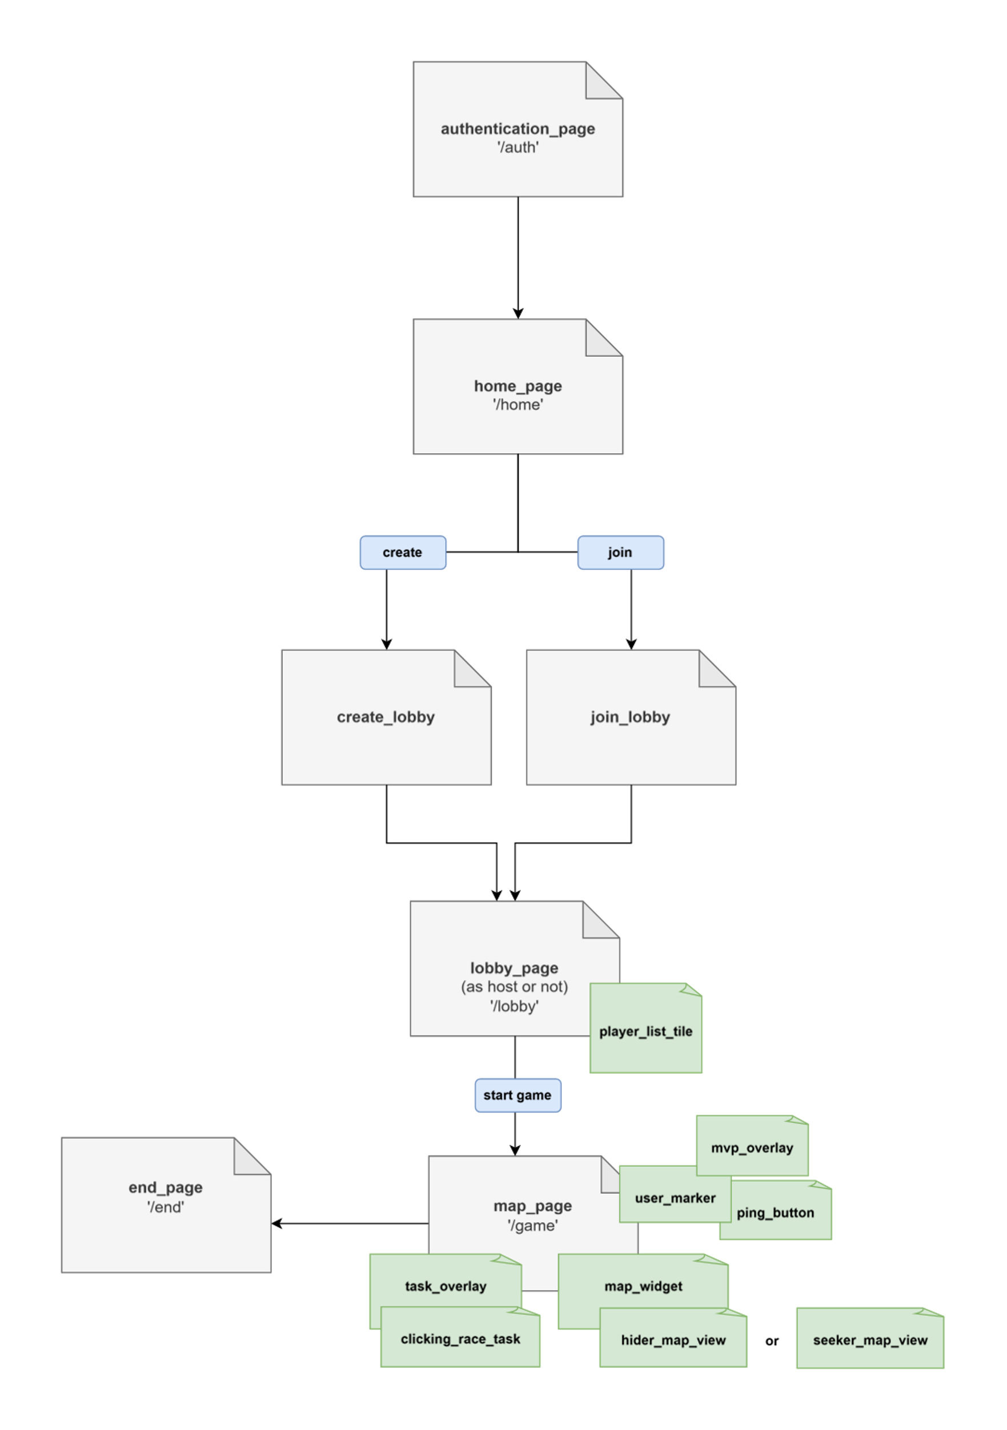
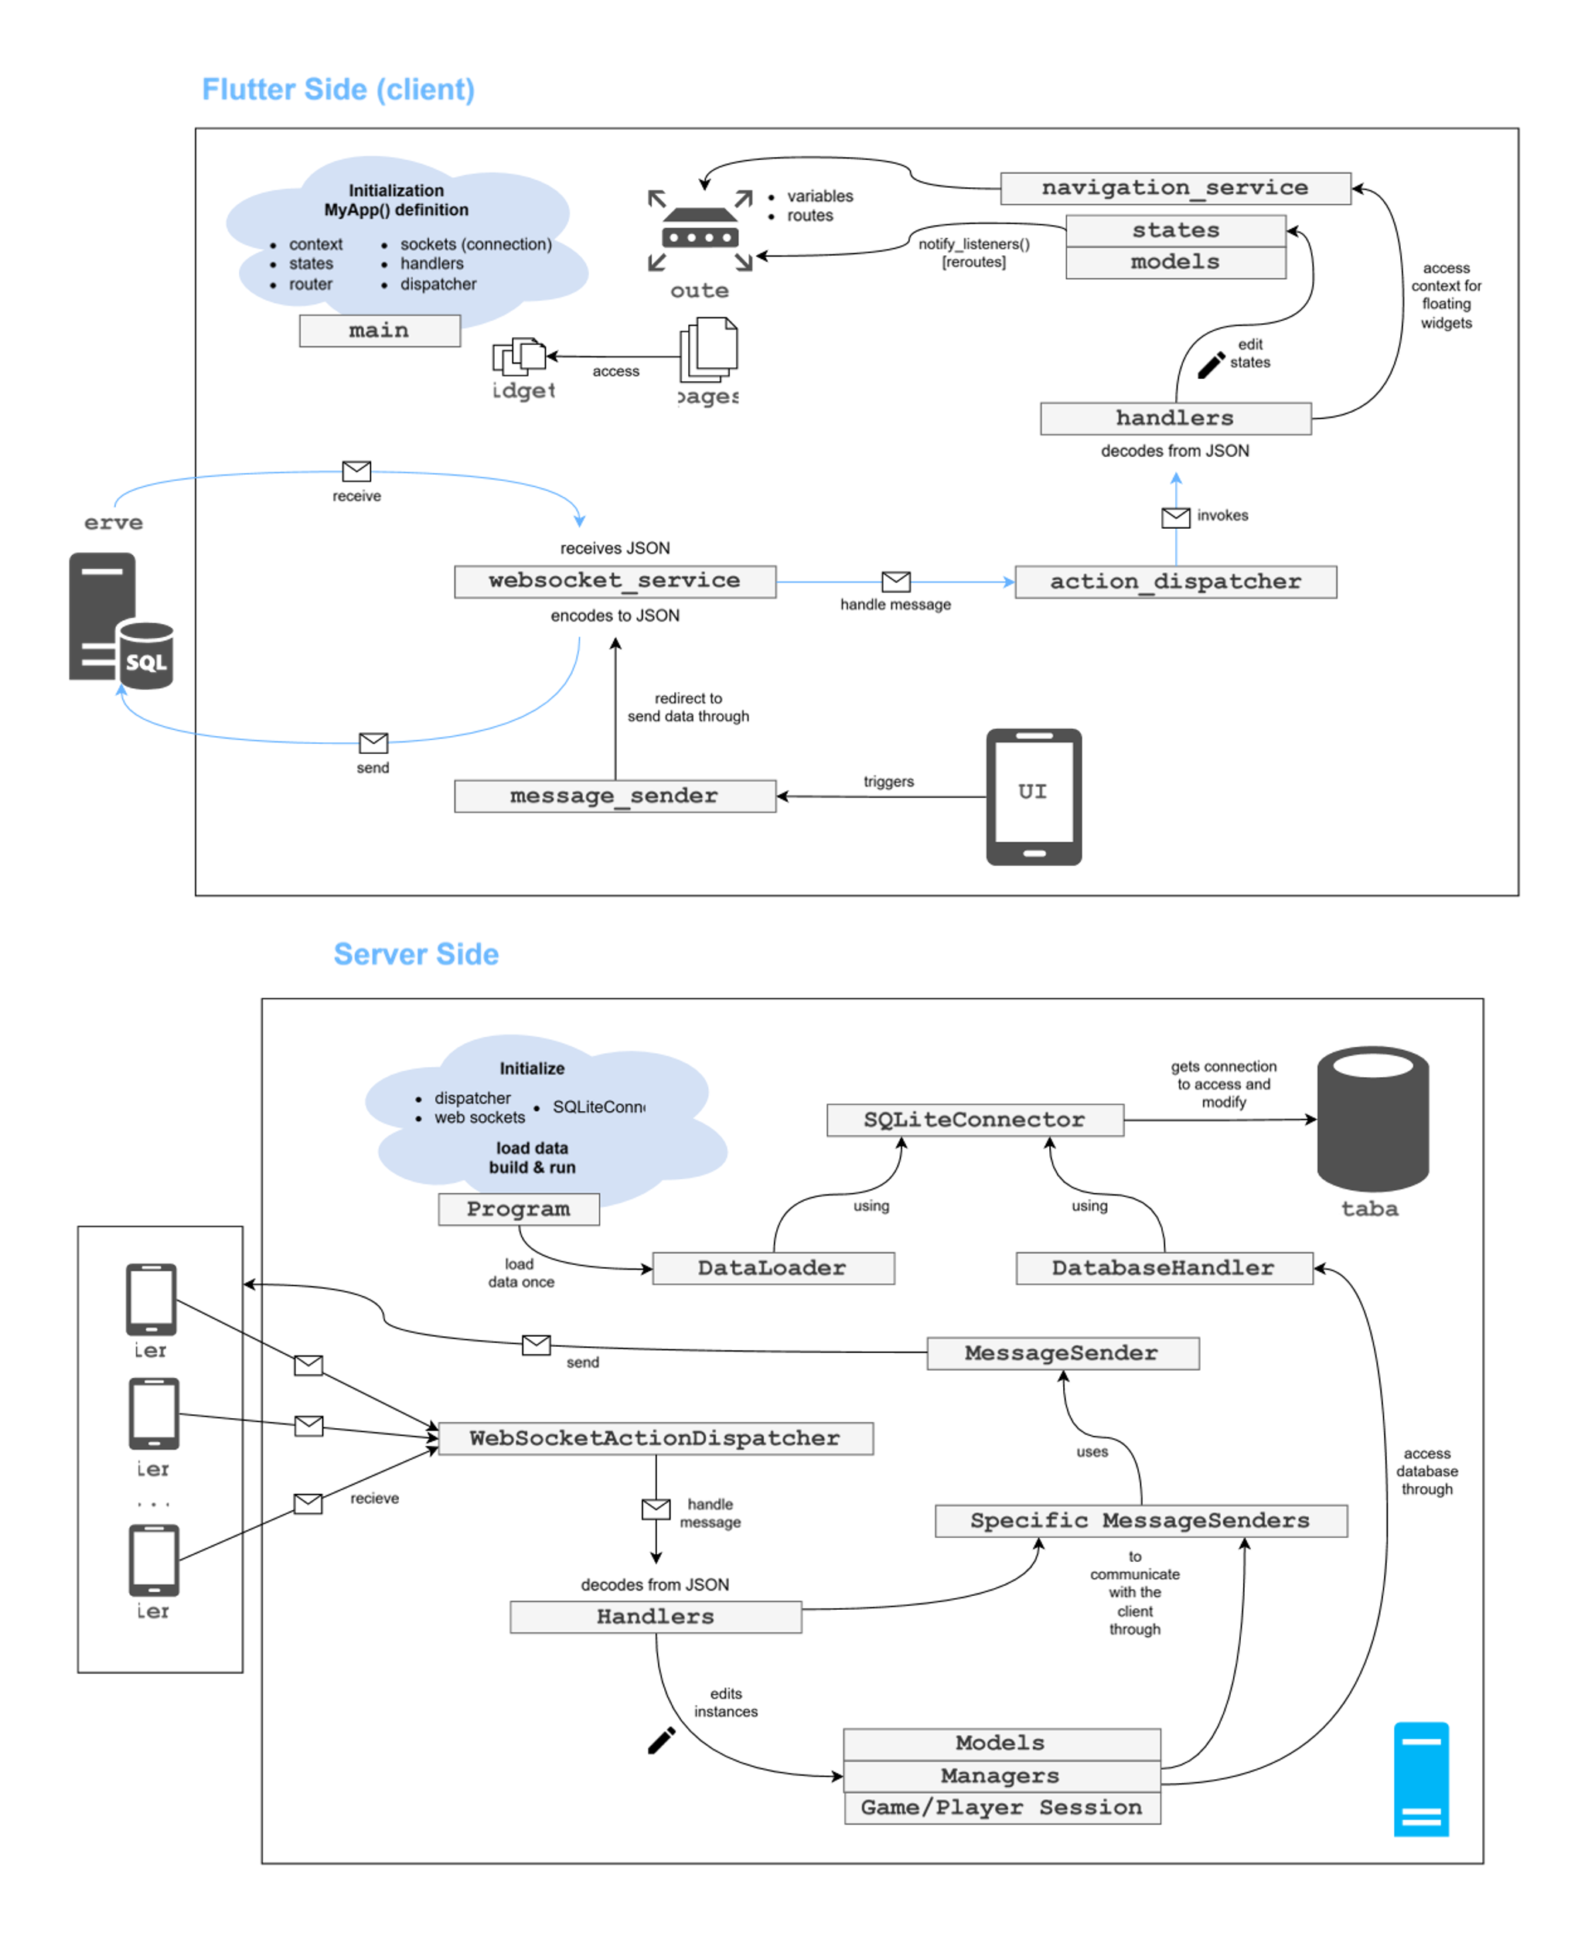
SOLUTION’S ARCHITECTURE

Slide 16
SOLUTION’S ARCHITECTURE

Slide 17






MAIN FEATURES
AUTHENTICATION
MULTI-PLAYER LOBBY
GAME LOGIC
WEBSOCKET SERVICES
ASYNCHRONOUS
TASKS
FLUTTER
SERVICES

Slide 18







DIFFICULTIES & SOLUTIONS
Git Merging
Refactoring
Different Environments
Solution: coding together and more conscious developing
Solution: more research before implementing and establishing and sticking to a design
Solution: spend time researching alternatives and “trial and error”

Slide 19




DIFFICULTIES & SOLUTIONS
Switching the UI
Debugging in Multiple Devices
Team Restructuring
Solution: reduce UI’s logic coupling (separate logic from UI in Flutter).
Solution: with repetition we got used to the methodology and learnt the best practices. Also stopped using emulator.
Solution: better defined roles, better and more constant communication, etc.

Slide 20
Documentation
All the documentation and extra information is written and explained in the GitHub:
https://github.com/rodrigocastro27/SemesterprojectSS25.git

Slide 21
DEMO Now it's time to PLAY!

Slide 22
Thank You! Semester Project SS2025
Aurora, Daniel, Kuba, Rodrigo
Final Project Presentation, 25th June 2025

